Slide 1
Vulnerable Barrier Option Under Merton’s Structure Model
財金所 潘政宏

Slide 2
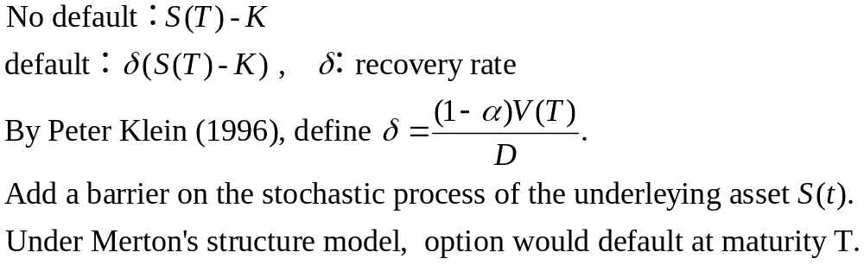
Vulnerable barrier option

Slide 3
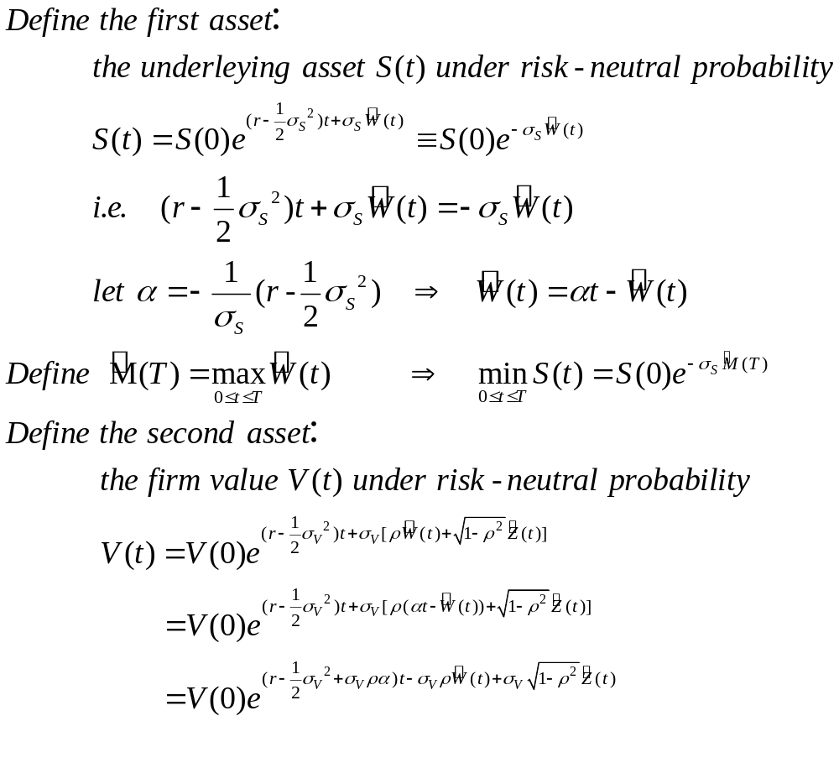

Slide 4
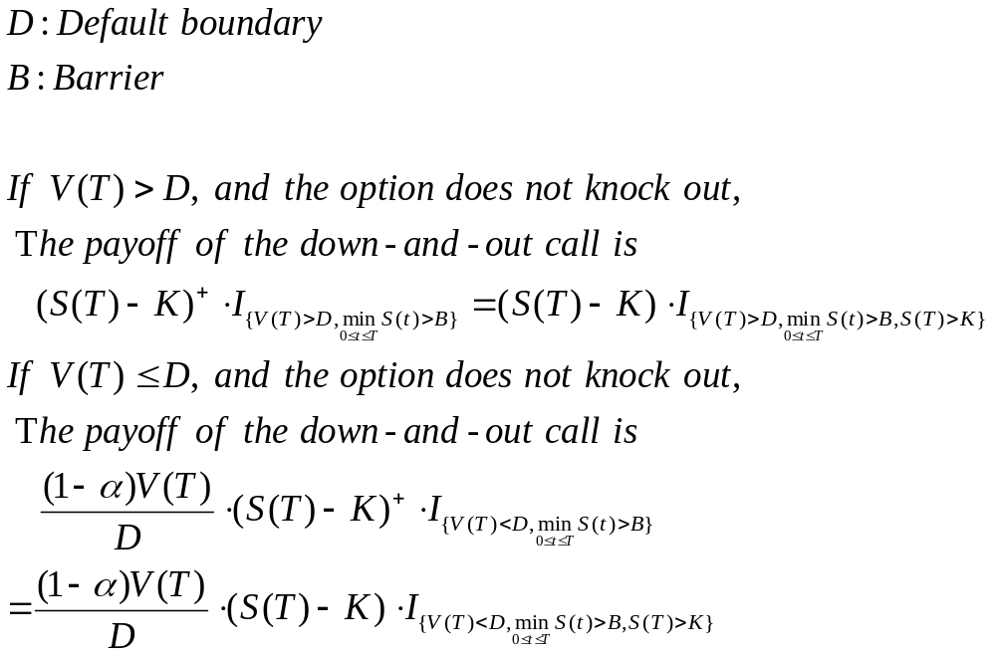

Slide 5
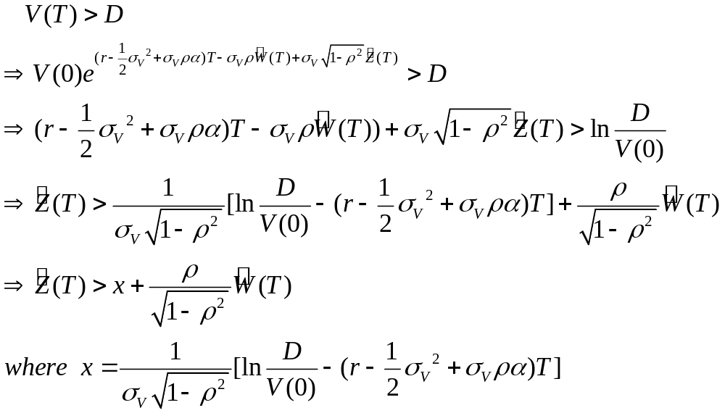

Slide 6
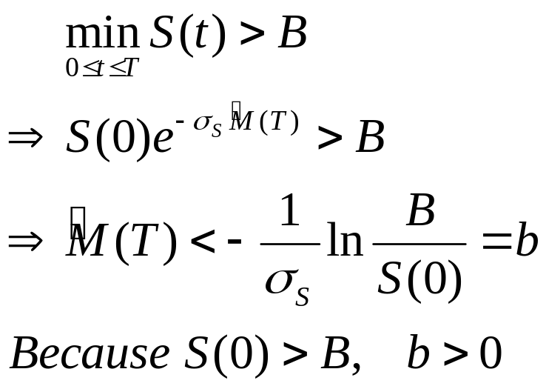
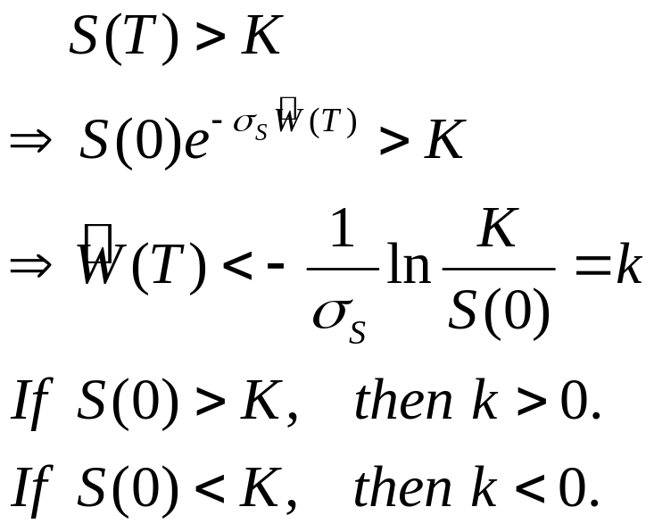

Slide 7
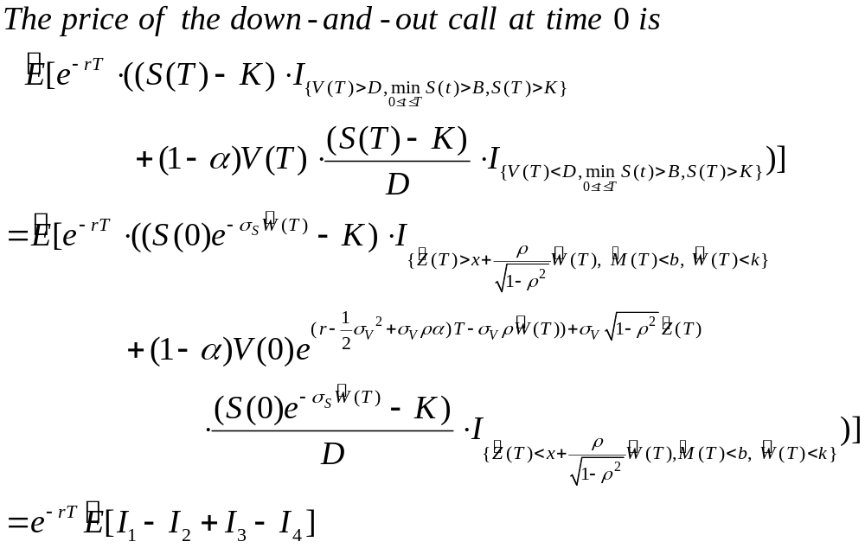

Slide 8
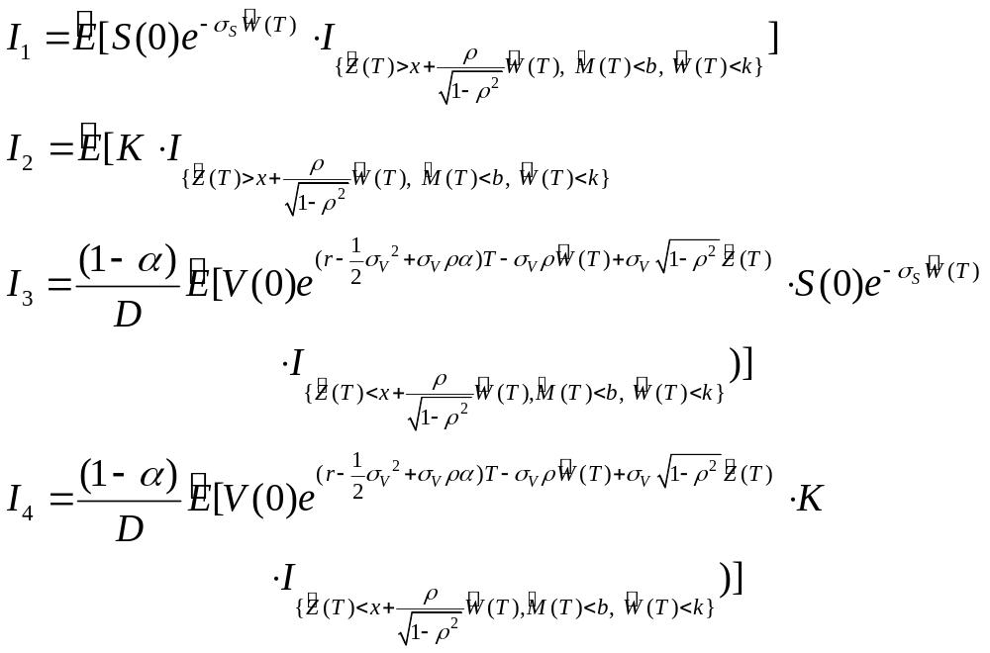

Slide 9







Consider the integral region

Slide 10
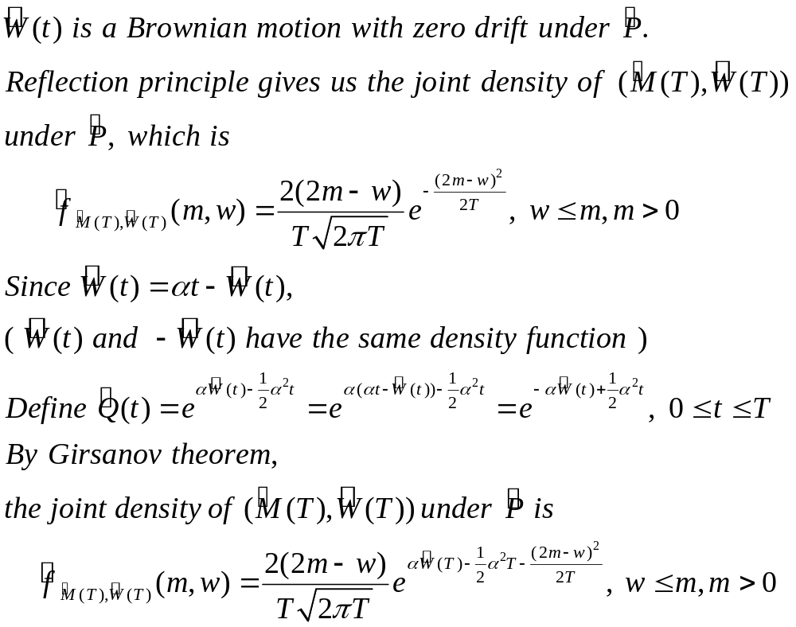

Slide 11
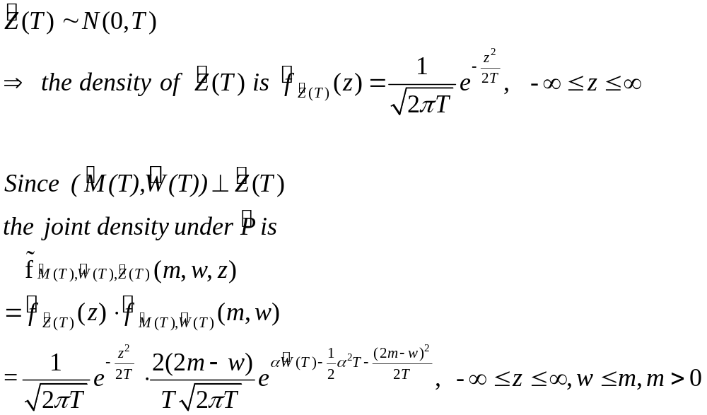

Slide 12
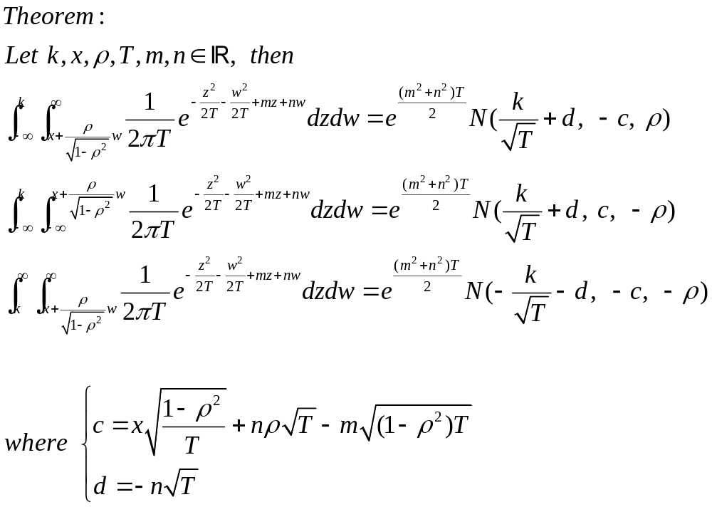

Slide 13
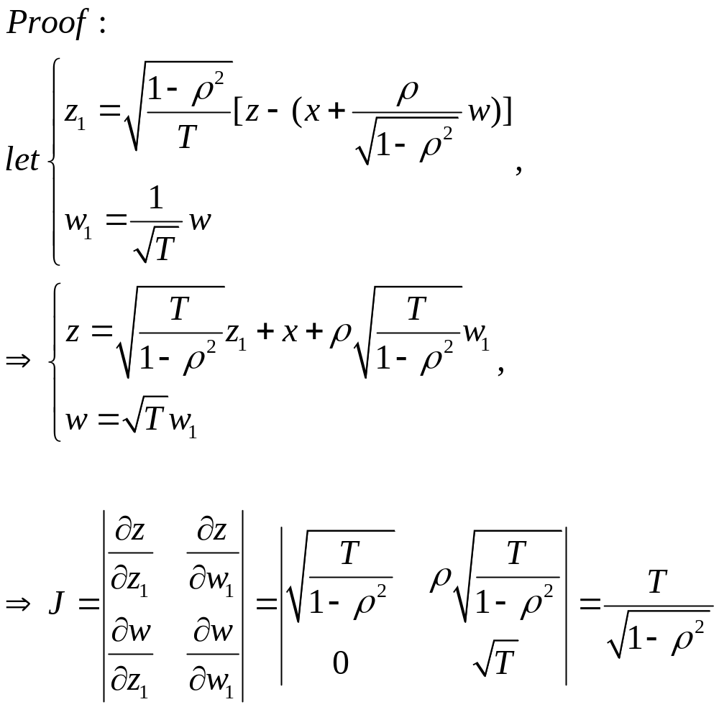

Slide 14
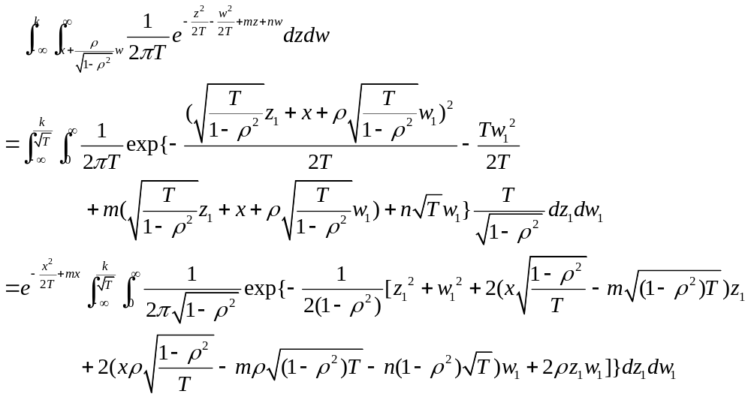

Slide 15
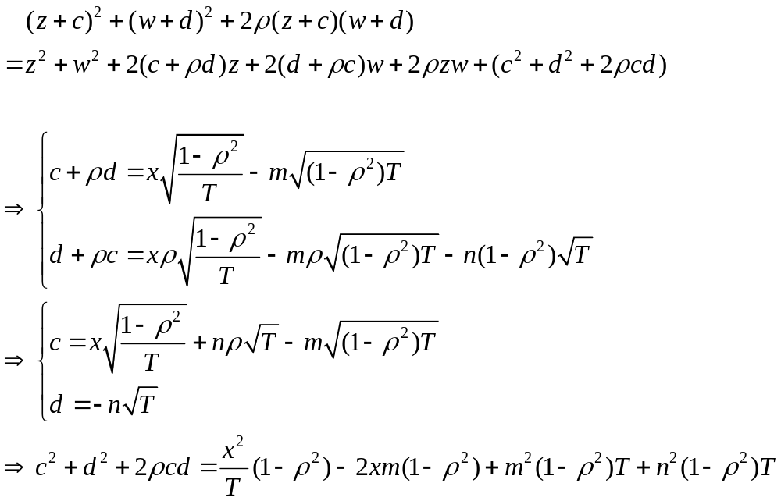

Slide 16
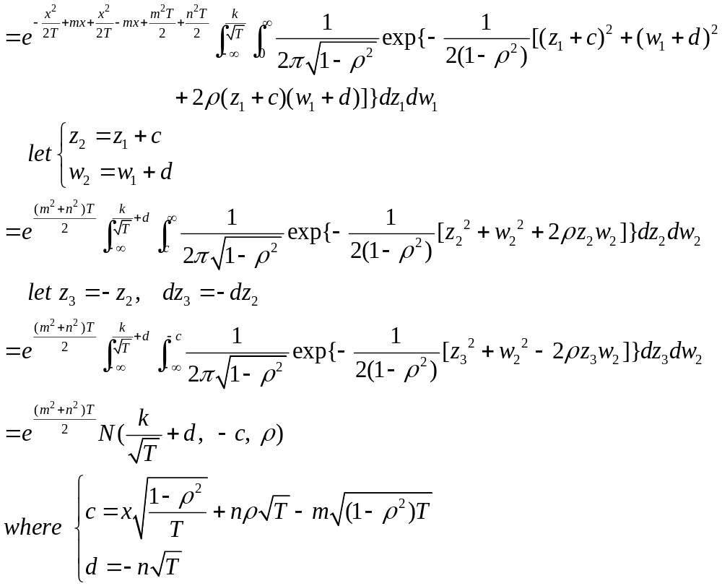

Slide 17
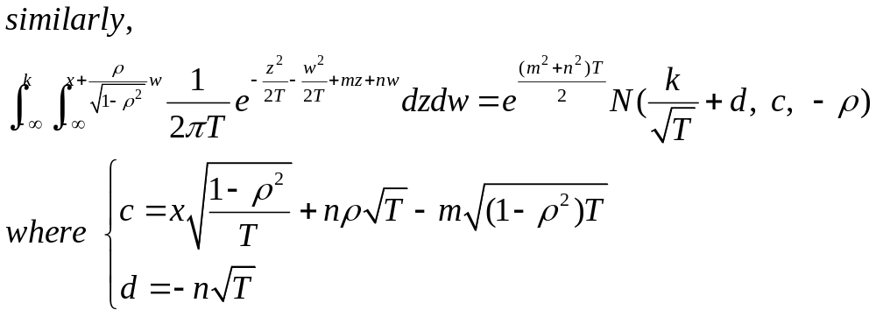

Slide 18
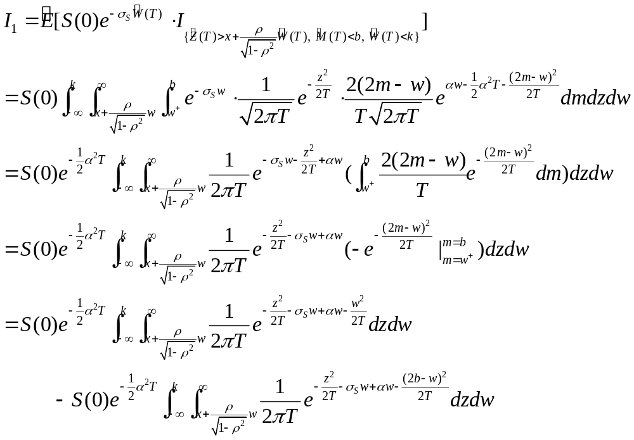

Slide 19
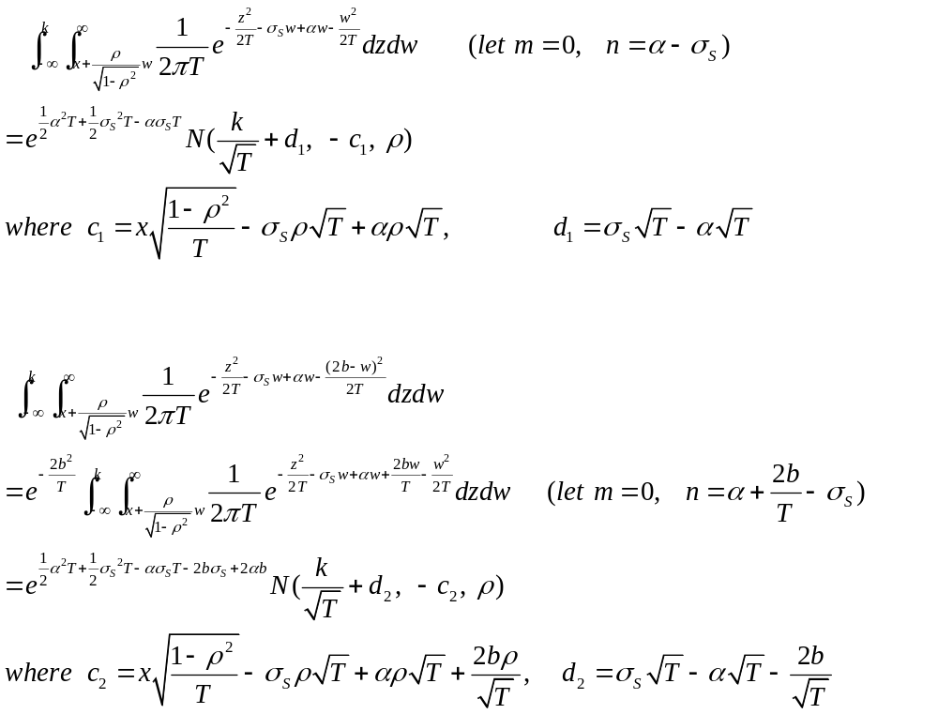

Slide 20
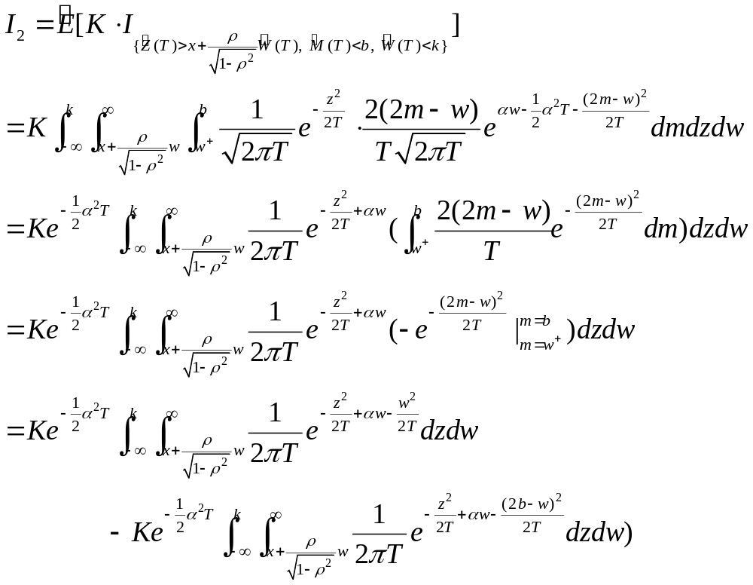

Slide 21
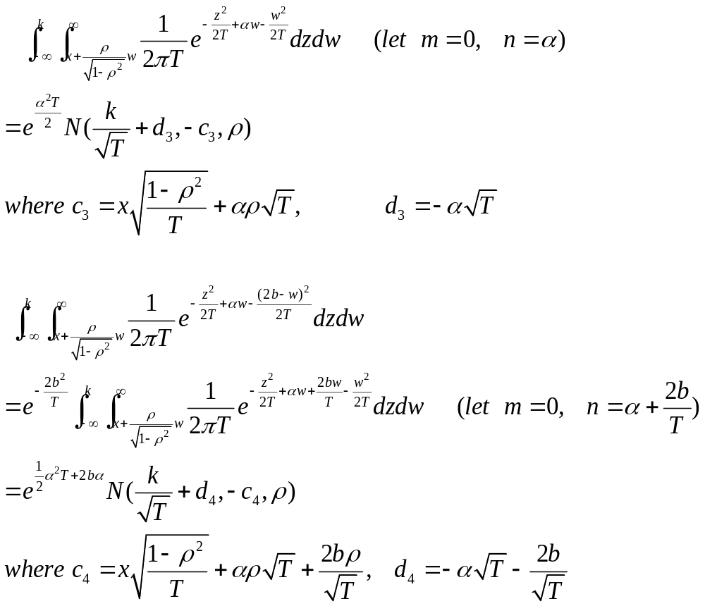

Slide 22
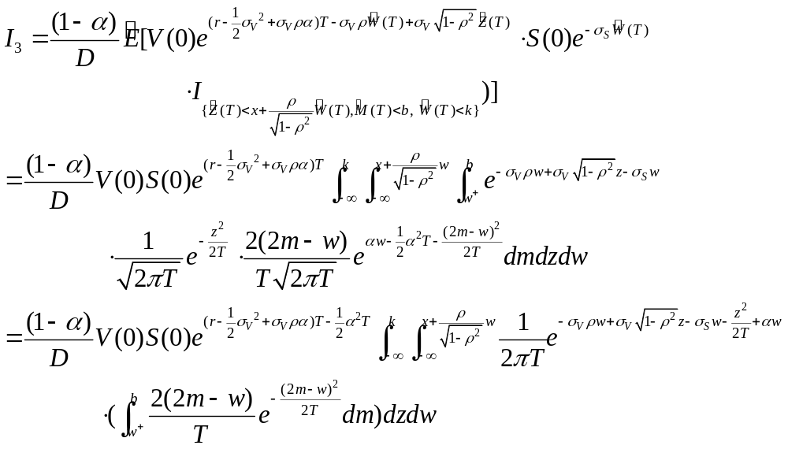

Slide 23
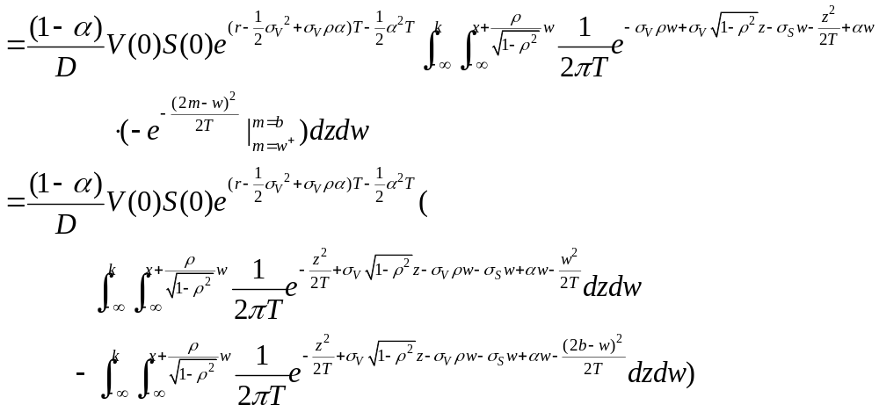

Slide 24
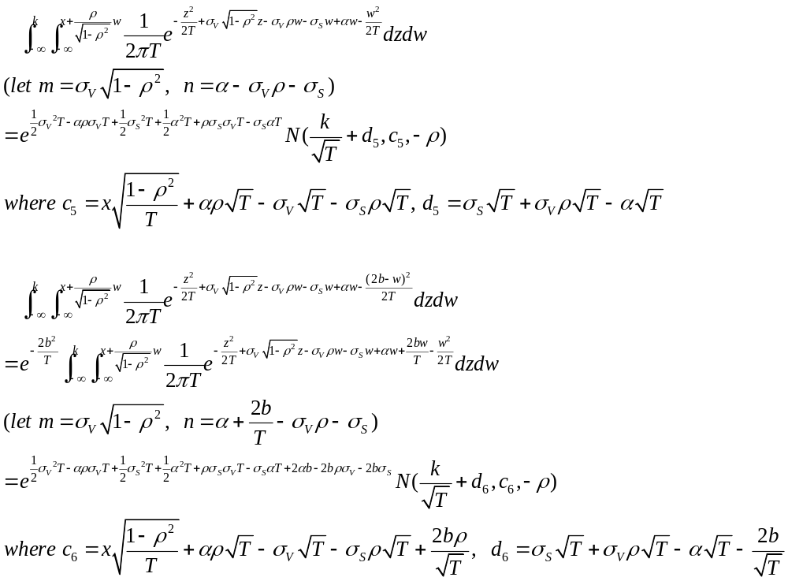

Slide 25
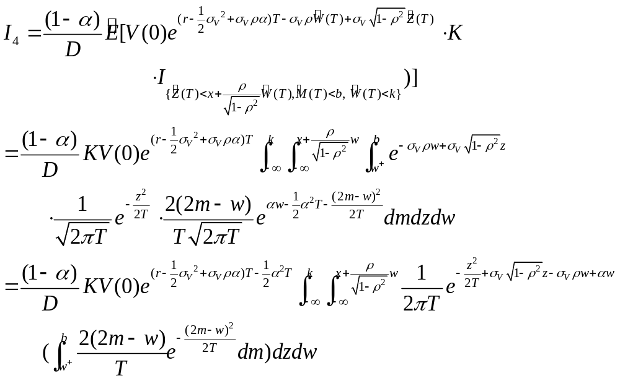

Slide 26
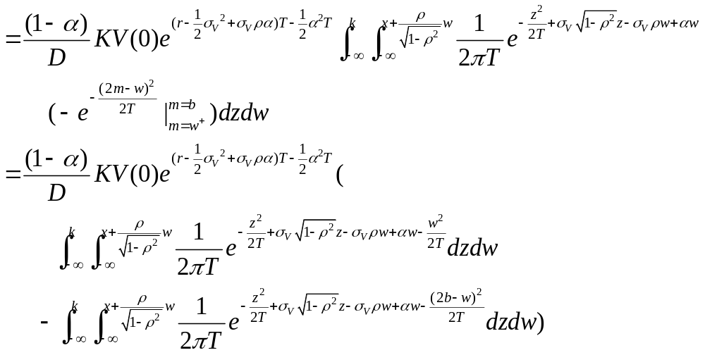

Slide 27
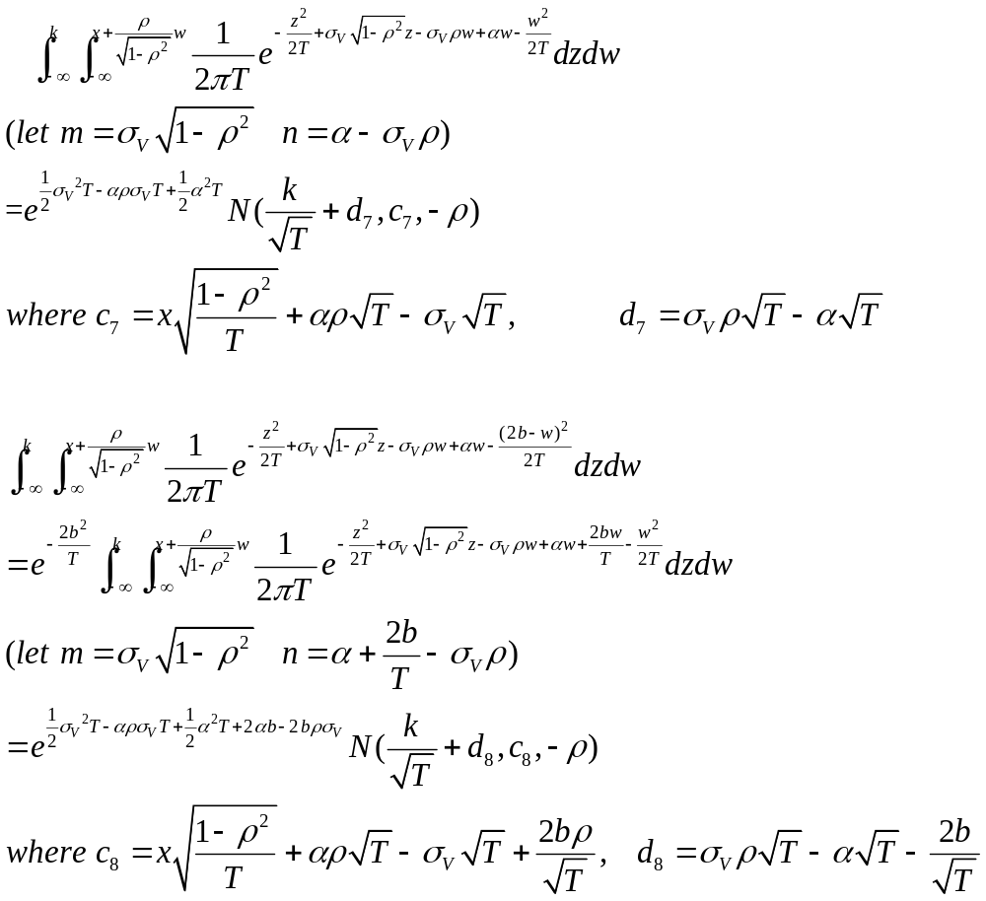

Slide 28
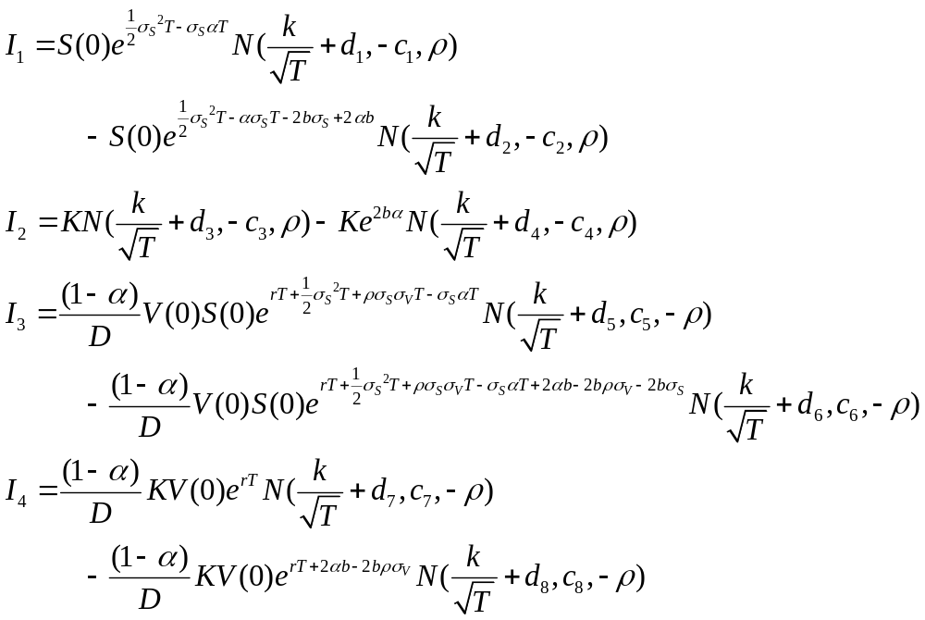

Slide 29
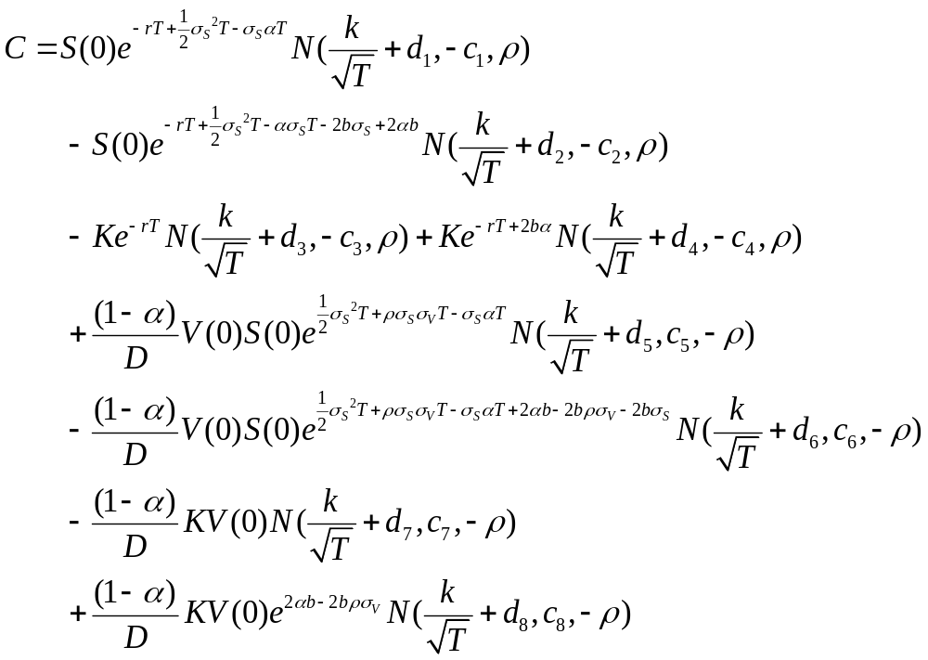

Slide 30
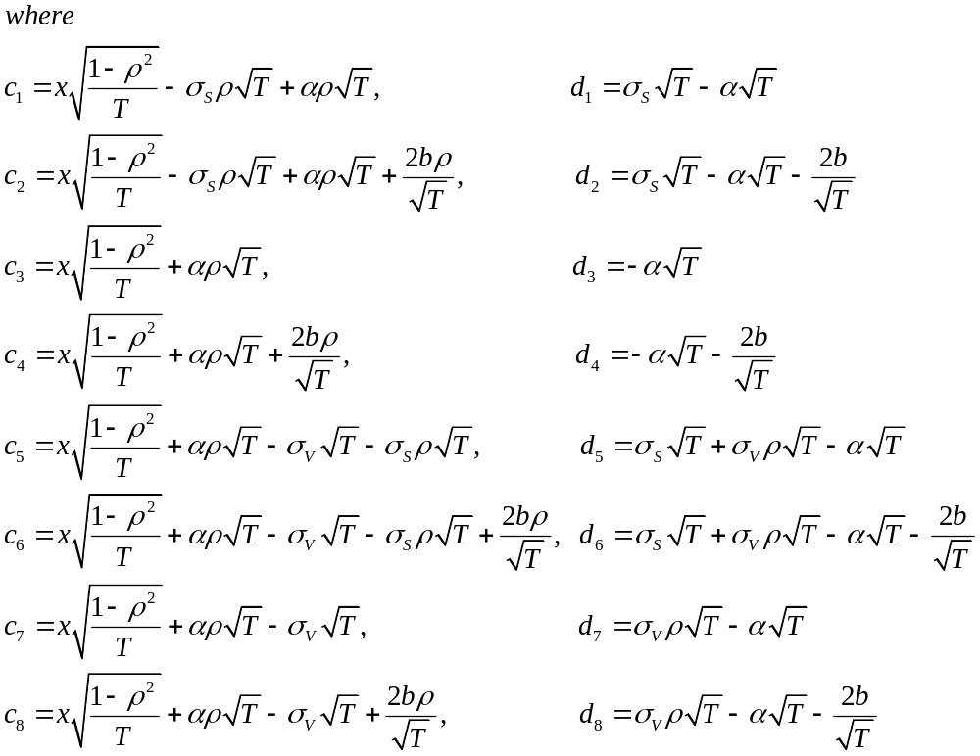

Slide 31
若障礙價格B趨近於0，理論上Vulnerable barrier option會趨近於Peter Klein(1996) Vulnerable option的封閉解。
令B=0.000000001
Base case: S(0)=40, K=40, V(0)=100, D*=90, T=3, α=0.25, sigma V=0.2, sigma S=0.2, rho=0,r=0.05
 | Base Case | S=30 | V=110 | rho=0.5 | Sigma S=0.15 | Sigma V=0.15 | T=4 | α=0 | r=0.07
潘政宏 | 7.442009 | 2.273429 | 7.740897 | 8.057731 | 6.447346 | 7.799244 | 8.916267 | 7.931773 | 8.800805
Peter Klein | 7.44 | 2.27 | 7.74 | 8.06 | 6.45 | 7.8 | 8.91 | 7.93 | 8.8

Slide 32
與劉彥君學長的程式跑出來之值做比較
Base case: S(0)=40, K=40, V(0)=100, D*=90, T=3, α=0.25, sigma V=0.2, sigma S=0.2, rho=0,r=0.05
 | Base case | B=20 | B=25 | B=30 | B=40 | S=50 | V=90 | V=110 | rho=0.5 | rho=-0.5
潘政宏 | 5.388857 | 7.441921 | 7.428495 | 7.150082 | 0 | 14.30664 | 5.088935 | 5.605286 | 5.862597 | 4.686723
劉彥君 | 5.35141 | 7.395705 | 7.387199 | 7.106031 | 0.755121 | 14.22435 | 5.055862 | 5.572912 | 5.837087 | 4.650032
 | Sigma S=0.15 | Sigma S=0.25 | Sigma V=0.15 | Sigma V=0.25 | T=2 | T=4 | α=0 | α=0.5 | r=0.03 | r=0.07
潘政宏 | 5.440602 | 5.301374 | 5.647535 | 5.144767 | 4.614853 | 5.999847 | 5.743501 | 5.034213 | 4.369953 | 6.517149
劉彥君 | 5.398823 | 5.268926 | 5.622521 | 5.095175 | 4.596493 | 5.943043 | 5.730448 | 4.972373 | 4.344996 | 6.465648

